Slide 1
Collaboration 101
Warts and All
Notes:
Hi, My name is Shirley Bailey … intro
Teacher, LOL TKS - 7th year, 3 year in a flexible/innovative learning space. Initially worked across two single cell classes. Now in a large space.

Slide 2
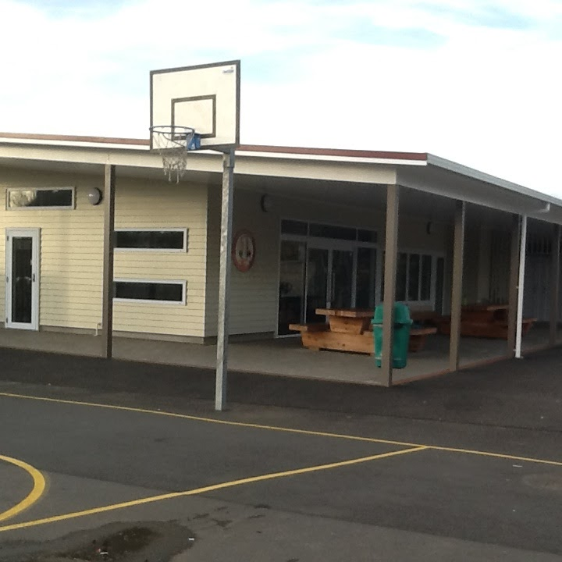
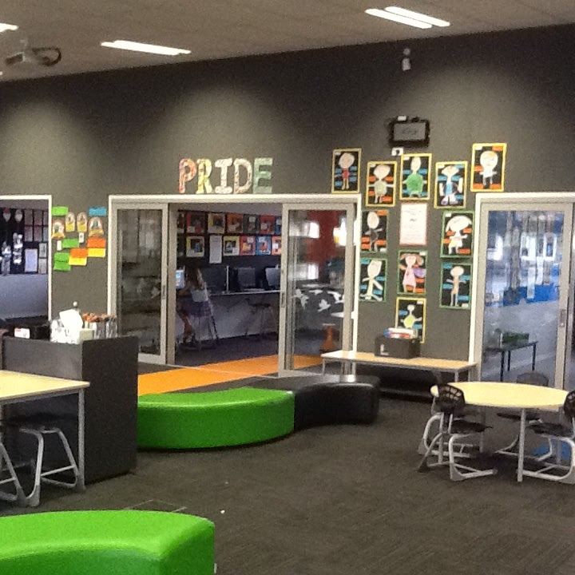
Notes:
This is our space - built in 2014

Slide 3
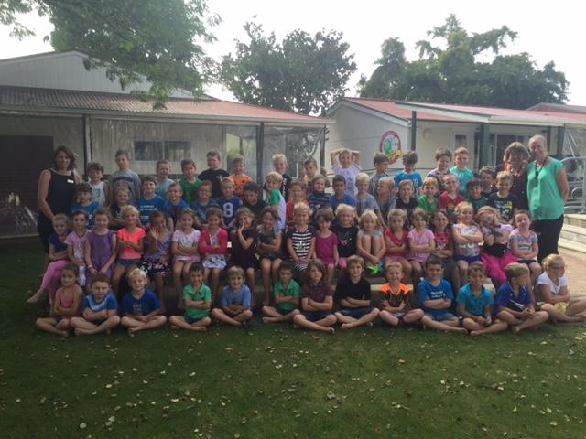

Slide 4
The walls have gone, the teaching team has been established. Now go forth –
teach together,
plan together,
co–exist together,
learn together,
have fun together,
cry together and …
don’t forget to raise student achievement together.
Notes:
So now down to the day to day things that help make the magic happen.

Slide 5
We may not have it all together
But together we have it ALL
Notes:
We definitely don’t have it all … we don’t have a magic silver bullet … it’s never perfect … but our students are happy, our students are learning.
This quote from Neill O’Reilly from Waitakiri School, Chch resonated with me ... it’s not about latest acronym … it comes down to quality teaching and learning.

Slide 6
Before we CAN Collaborate …
Notes:
I guess an important place to start is with a set of ‘shared understandings’ ensuring all parties are on the same page.

Slide 7
Notes:
Originally when I started at TK our motto/vision was ‘to be our very best’. We worked together to create a new vision which underpins our teaching and learning. The term ‘learners’ refers to both teachers and students.

Slide 8
Respect
Notes:
Our PRIDE Values - a set of values we embed within our daily programme.
Values for our students and teachers alike.

Slide 10
Notes:
Our LQs - School in conjunction with parents and local businesses - set of qualities we believe students need to develop in order to become confident, connected 21st century citizens.

Slide 11
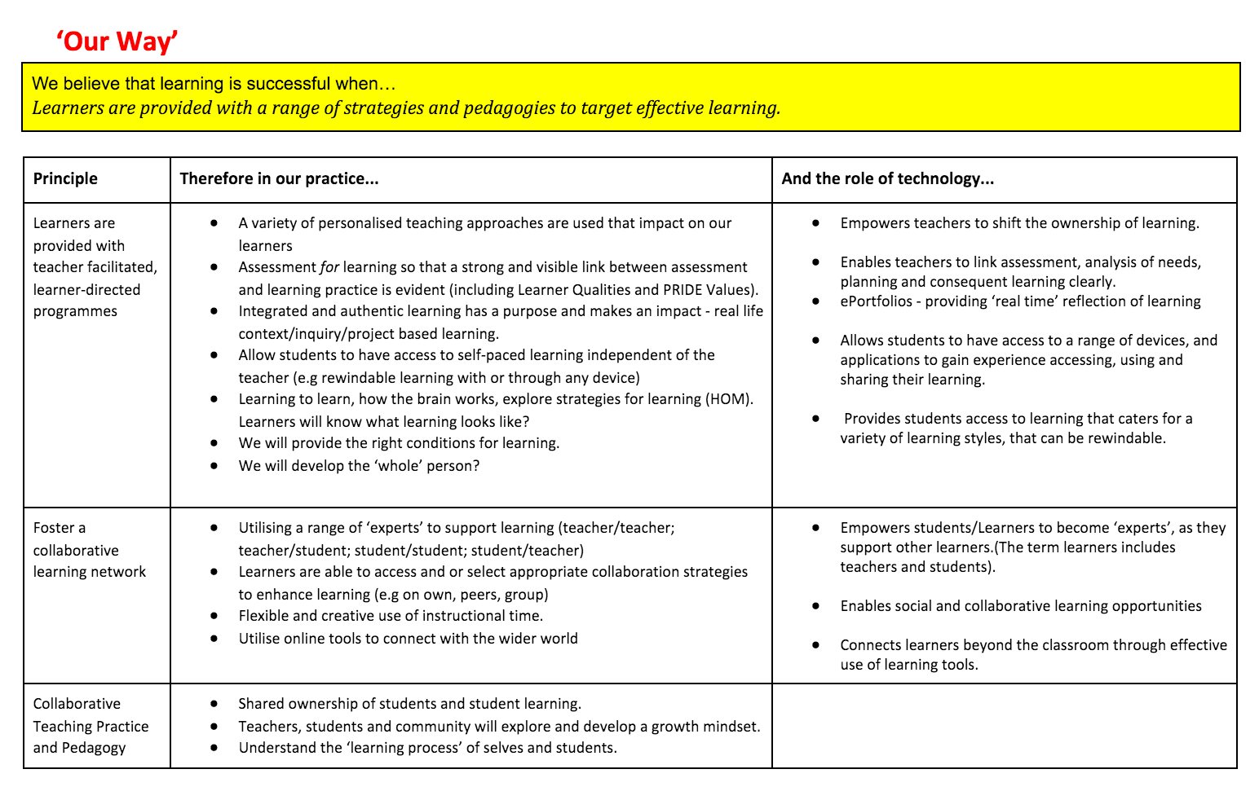
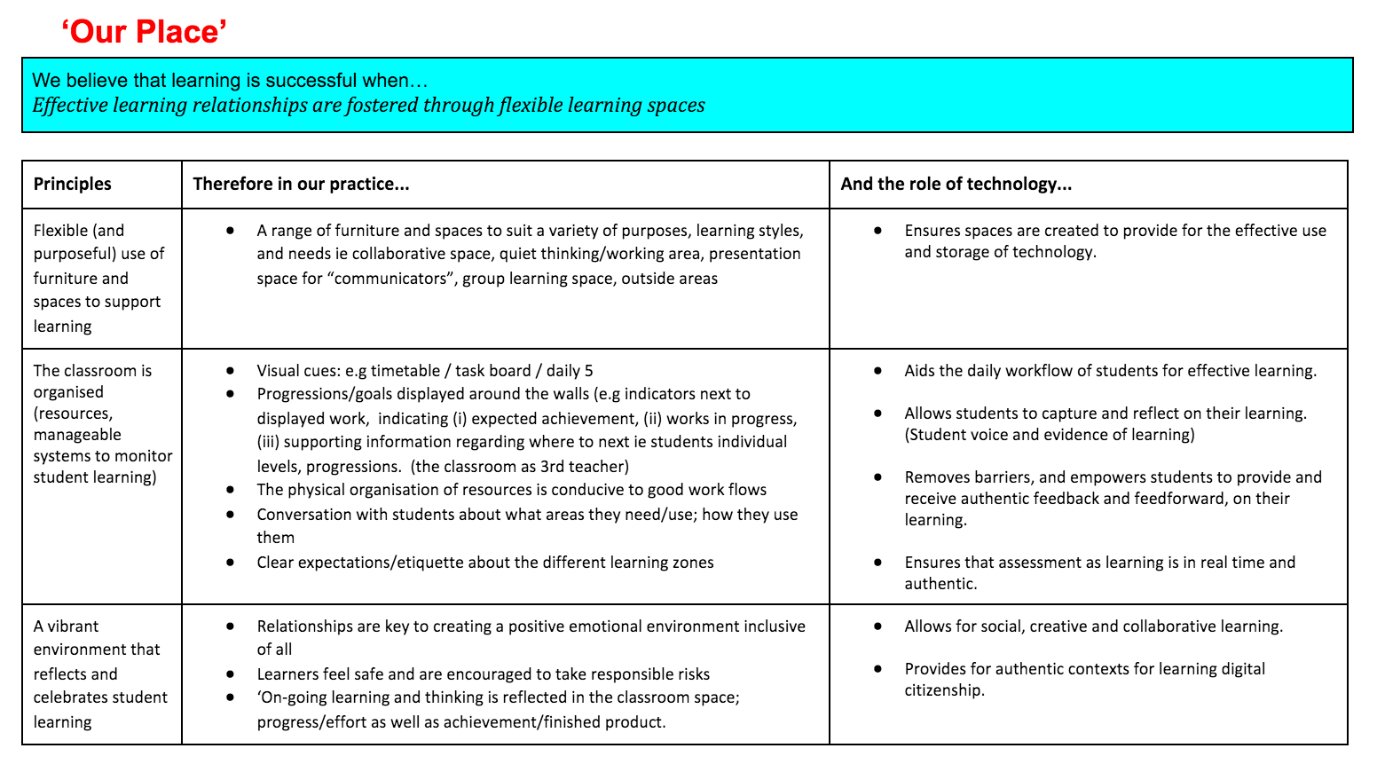
Key Principles - Our Gate Keeper
Key Principles
Key Principles Reflected Upon
Notes:
Set of principles created to reflect Our Learners, Our Place, Our Way
Our beliefs about learning at Te Kowhai School… ‘Our Learners’, ‘Our Place’, ‘Our Way’
The following show Te Kowhai’s key Teaching and Learning Principles; the key concepts and implications for practice at Te Kowhai and the links between these and eLearning.

Slide 12
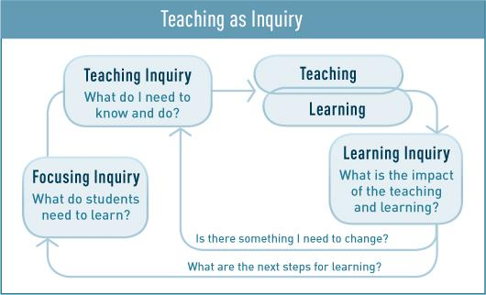
Notes:
Teaching as Inquiry - important part of our practice. Now explored collaboratively.
Originally driven by data - writing
Then two years - passion based - BYOD, iPads, leadership, etc. etc.
Now back to being driven by data results and school wide focus - writing - EPIC - evidence based planning inquiry cycle - track 6-9 students per collaborative LC. Then also work across communities in PLGs to research/discuss data and next steps etc.

Slide 13
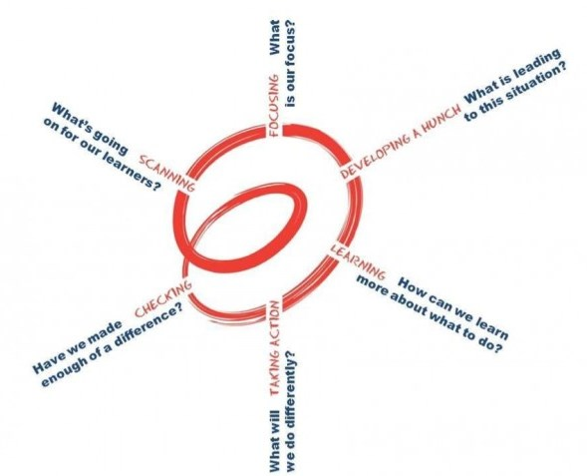
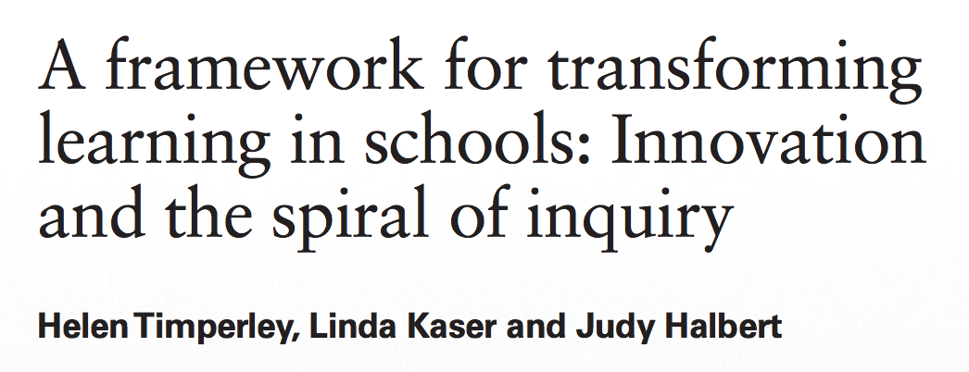
Notes:
Great 6 point cycle that helps breakdown the inquiry process.
Focussing
Developing a hunch
Learning
Taking Action
Checking
Scanning

Slide 14
Notes:
All of the above - helps provide evidence for the PTCs.
We record our reflections and add evidence against each PTC using MyPortfolio - online portfolio.

Slide 15
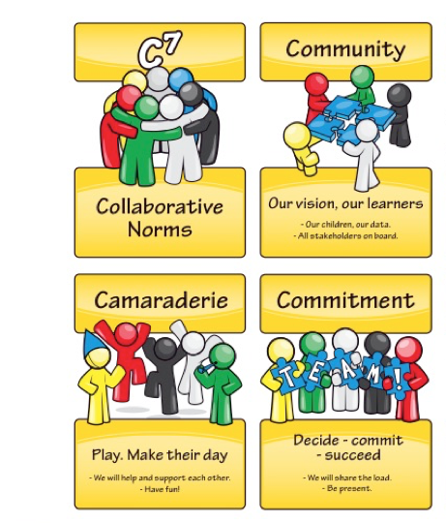
Notes:
Non Negotiables
How important is it to create a set of collaborative norms?
Different teachers, different expectations, finding the middle ground.

Slide 16
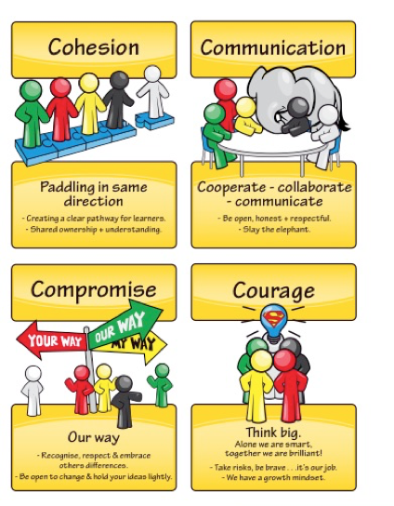
Collaboration Continuum
Notes:
Non Negotiables
How important is it to create a set of collaborative norms?
Different teachers, different expectations, finding the middle ground.

Slide 17
Learning Communities
Notes:
So now down to the day to day things that help make the magic happen.

Slide 18
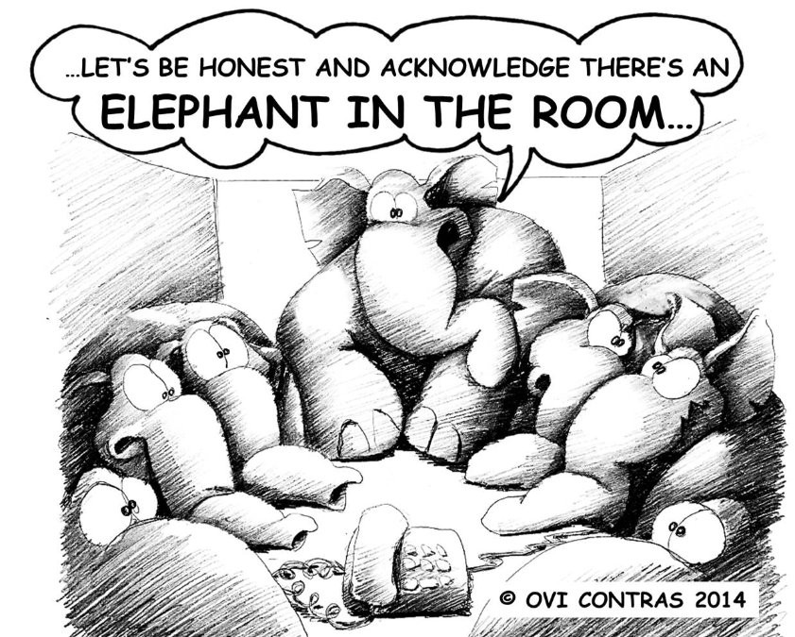
Notes:
Slay the Elephant
Why is open, honest and respectful communication important?

Slide 19
The Pencil Debate
Notes:
Share story of the pencil debate
The publishing folder debate

Slide 20
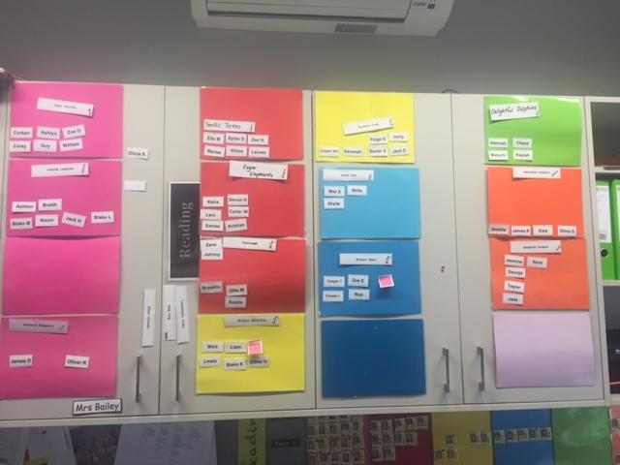
Data and Tracking
Notes:
Differentiated learning groups. Based on current needs.
Can better cater for our learners than I ever could in a single celled space. Eg. 3 groups at red - 3, 4, 5
Groups change regularly and discussions about students progress, needs etc. happen daily.
Groups are very fluid and change often.
We plan and teach across all levels - share re streamed groups as in the past.
System to track below, at risk etc.

Slide 21
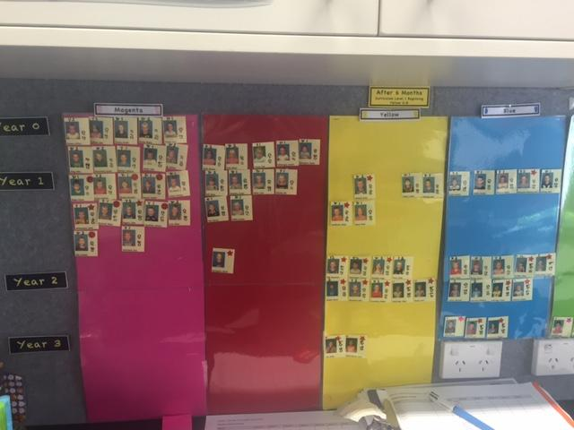
Data and Tracking
Notes:
Tracking across the wider team/LCs

Slide 22
Notes:
What does collaborative planning look like?
How do we plan, teach, assess and survive with 66 students together?

Slide 23
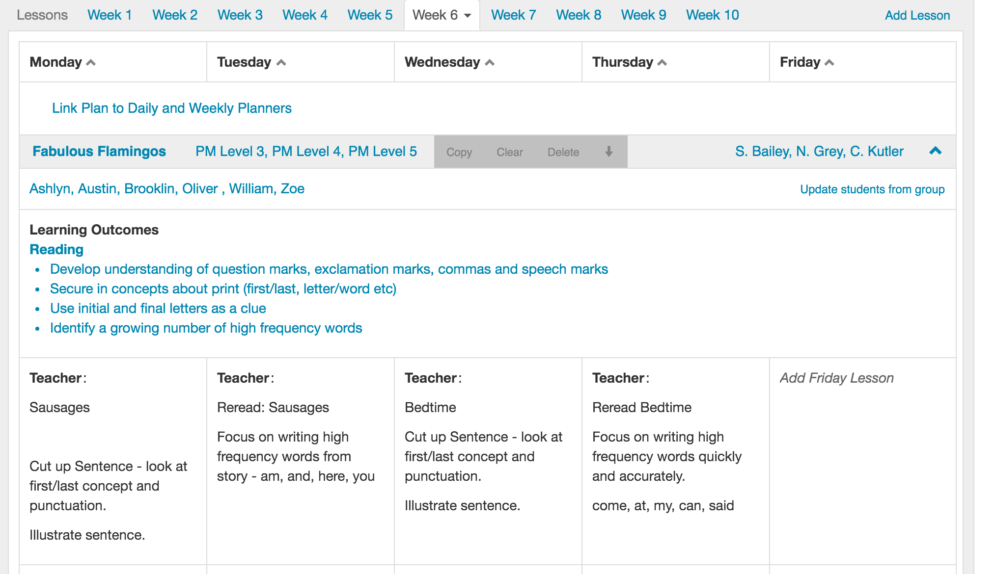
Notes:
What does collaborative planning look like?
How do we plan, teach, assess and survive with 66 students together?

Slide 24
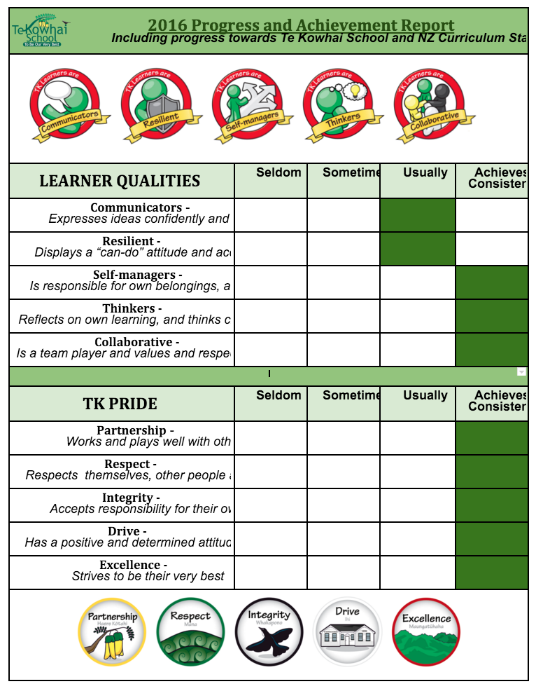
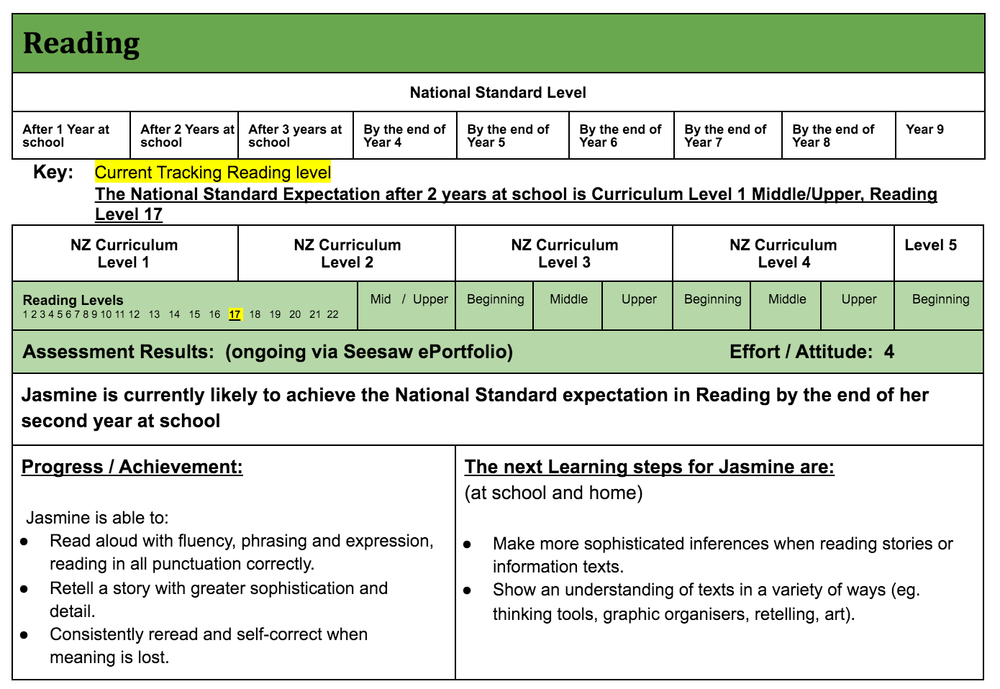
Notes:
Report collaboratively - google docs.
Comments are largely based on our learner progressions - progress/achievement and next steps.
One area we are currently working on revising is how we report against our PRIDE Values and LQs - are we reporting/reflecting on the whole child, or just their academic progress and next steps?

Slide 25
Notes:
What does learning look like with 3 teachers and 66 students? Hear about Daily 5 and Daily 3 – (the nuts and bolts of our literacy and numeracy).
Progressions
Groupings/Differentiation
Inquiry, Problem Solving

Slide 26
What is Daily Five and Daily 3?
Framework that holds no curriculum content.
Independent literacy/numeracy structure and classroom management system.
Consists of five/three tasks that teaches students independence and provides choice.
Notes:
Brief overview of D5 and D3

Slide 27
Why Daily Five and Daily 3?
Short whole class lessons
Target teach small groups
Conference with individuals
Assessment
Progressions
Explicitly enable students to build and maintain stamina.
Receive tailored instruction - whole class, small group, individual conferring - meeting individual needs
Reading and writing for extended periods of time
Develop independence and stamina
Provides choice (what, when, where)

Slide 28
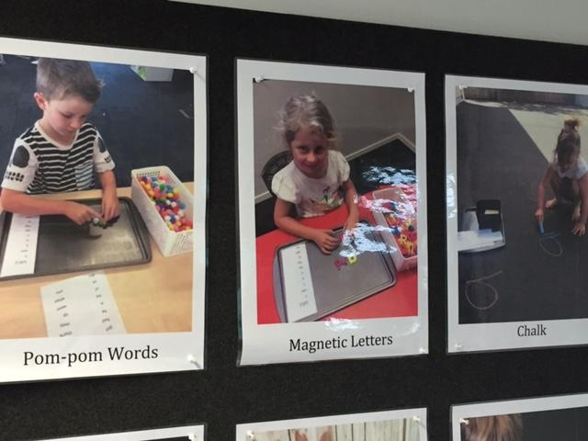
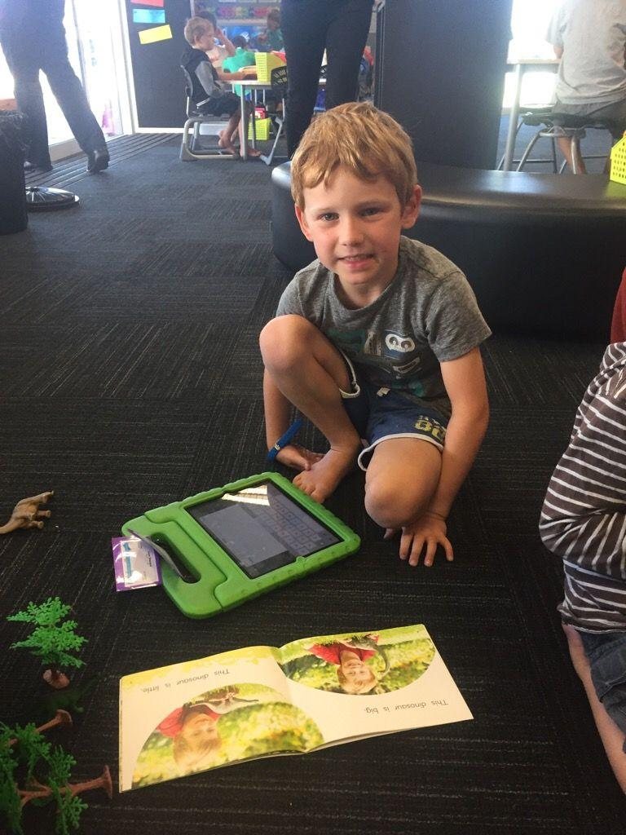
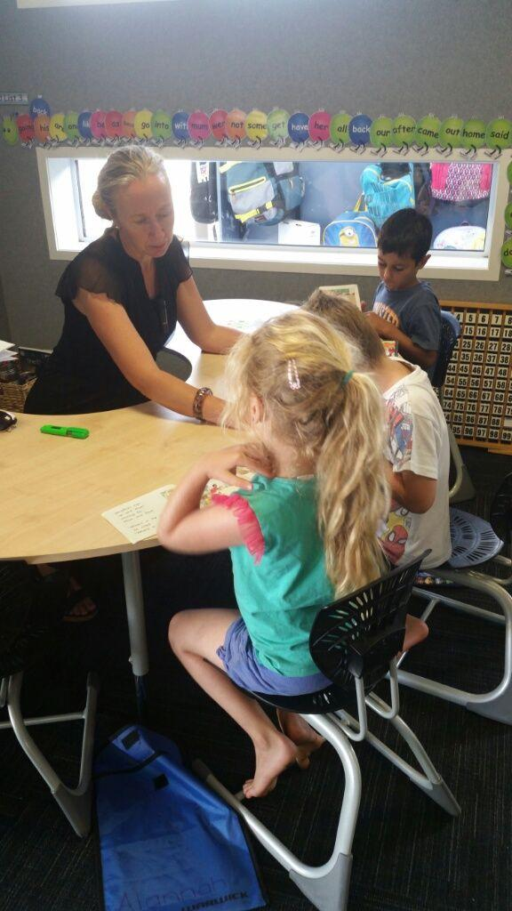
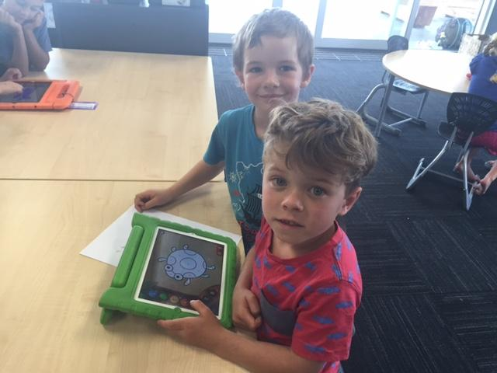
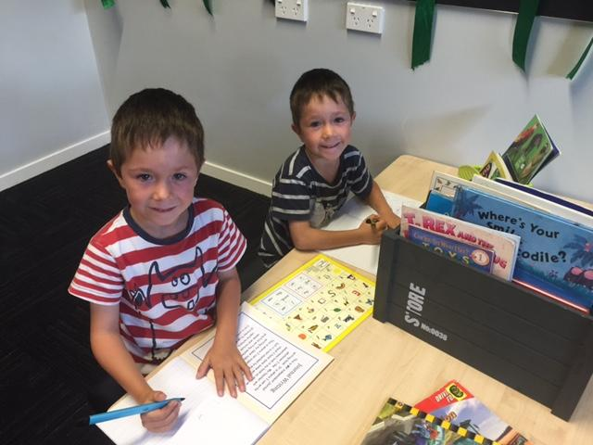
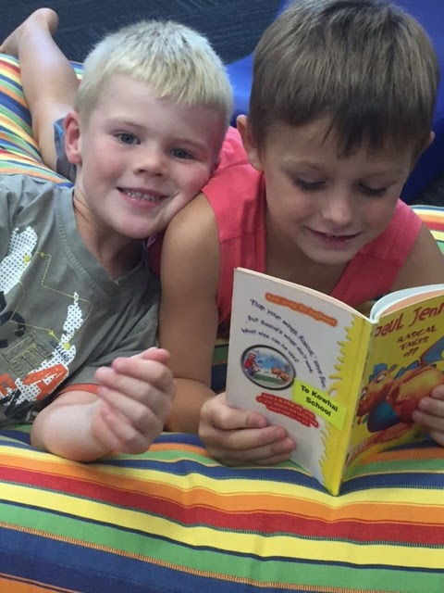
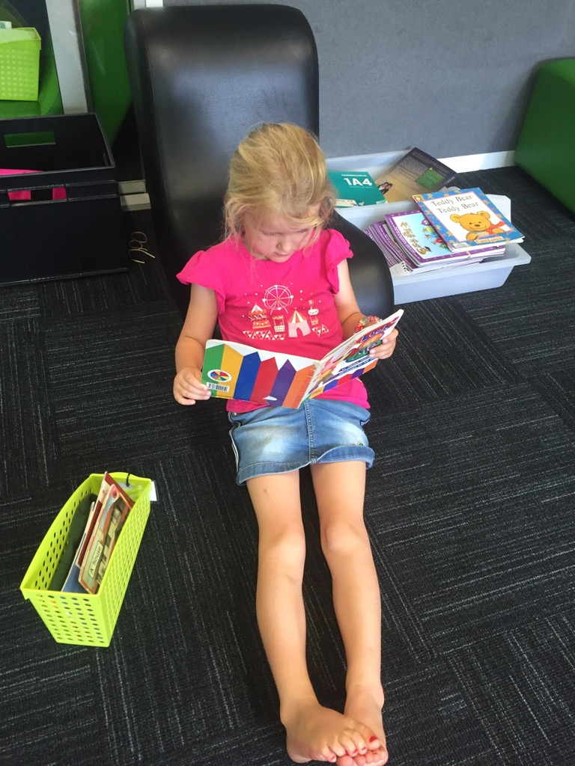

Slide 29
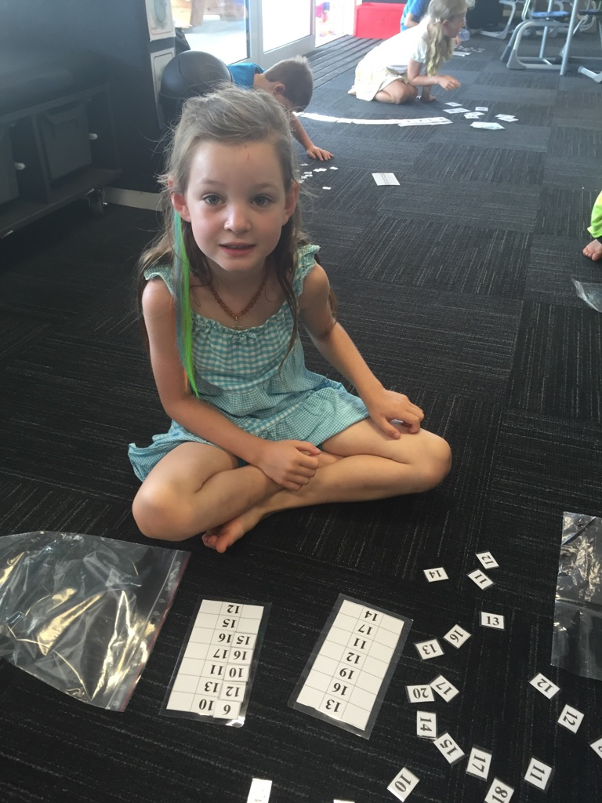
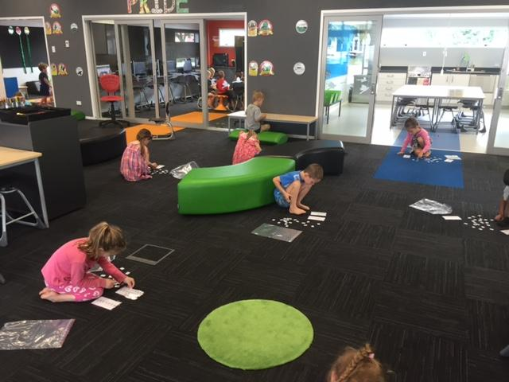
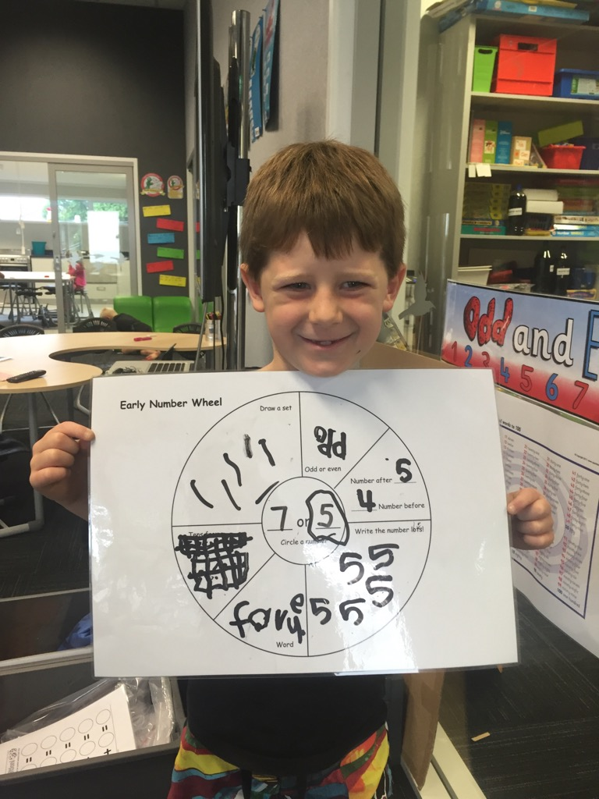
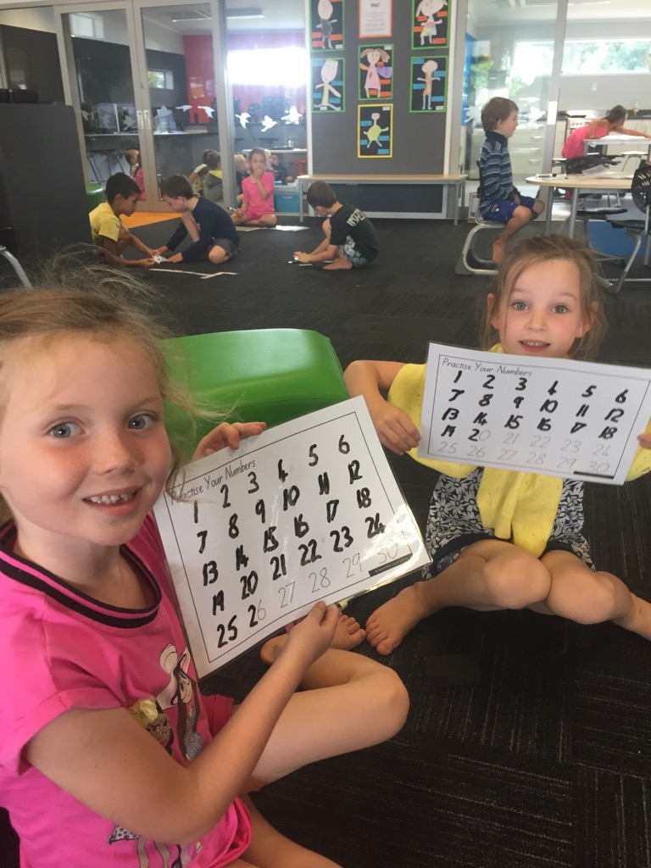
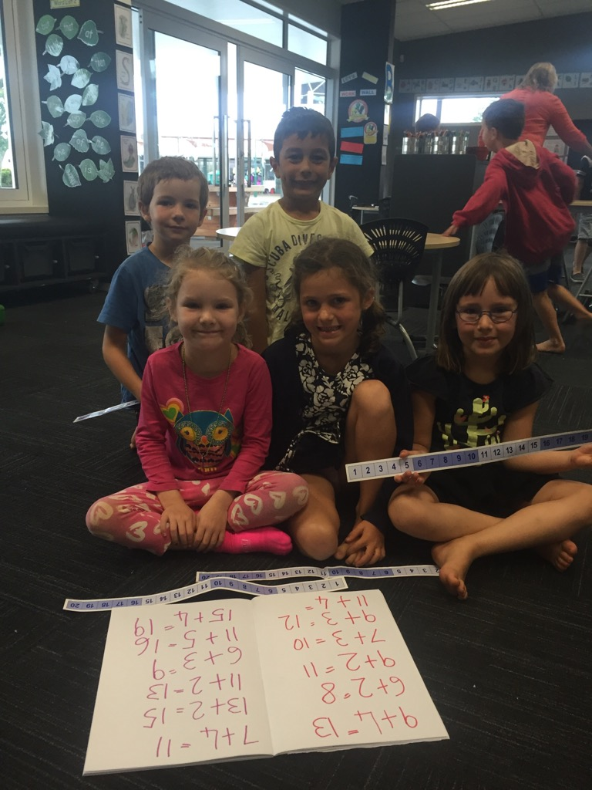

Slide 30
What does George have to say ...

Slide 31
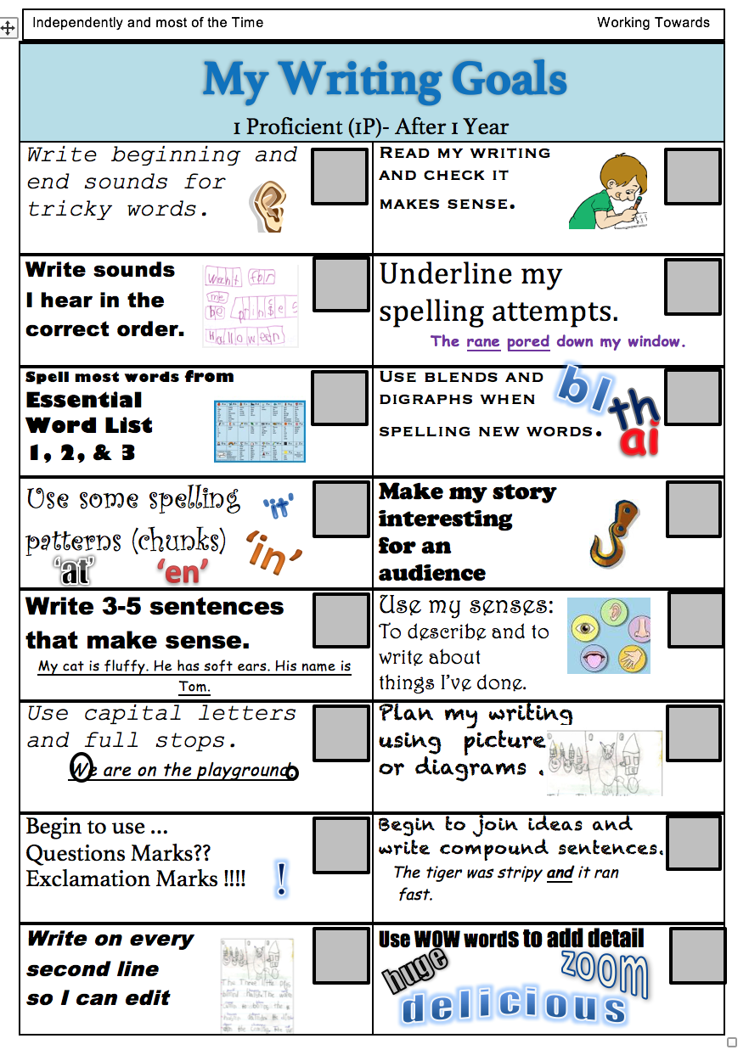
Notes:
Progressions to guide our teaching and students learning. And used to inform our OTJs

Slide 32
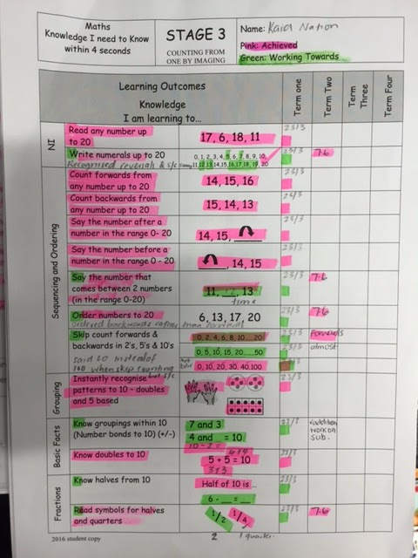
Notes:
ICAN for maths knowledge
Gloss for strategy.

Slide 33
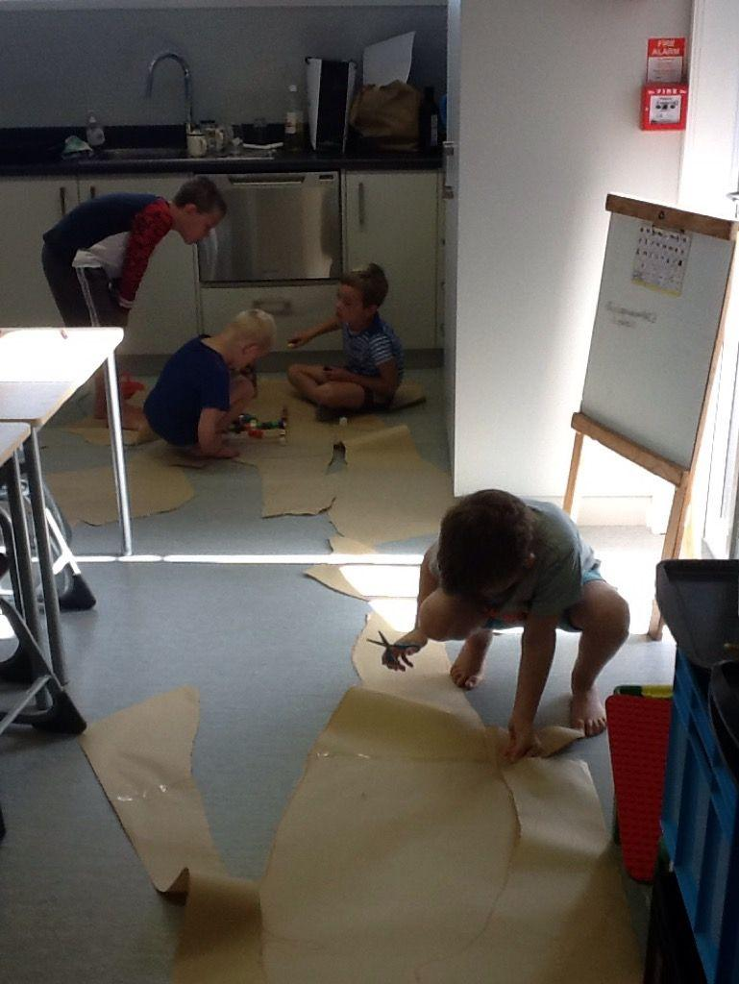
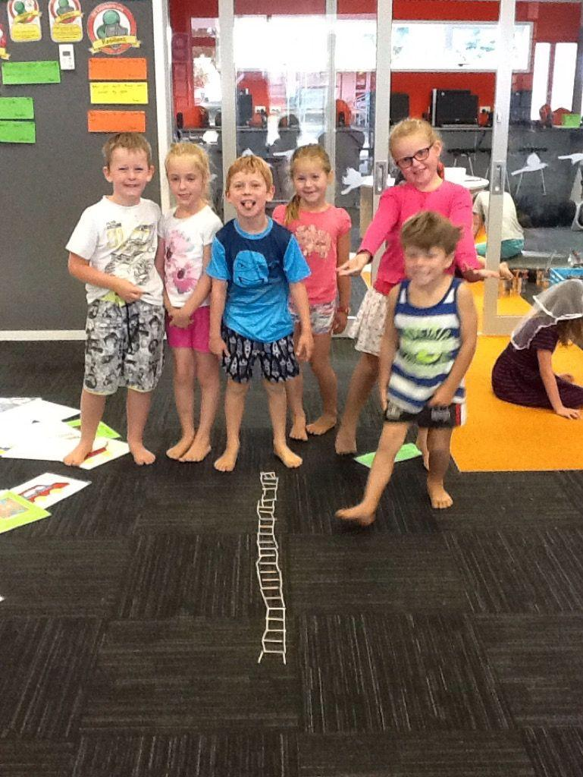
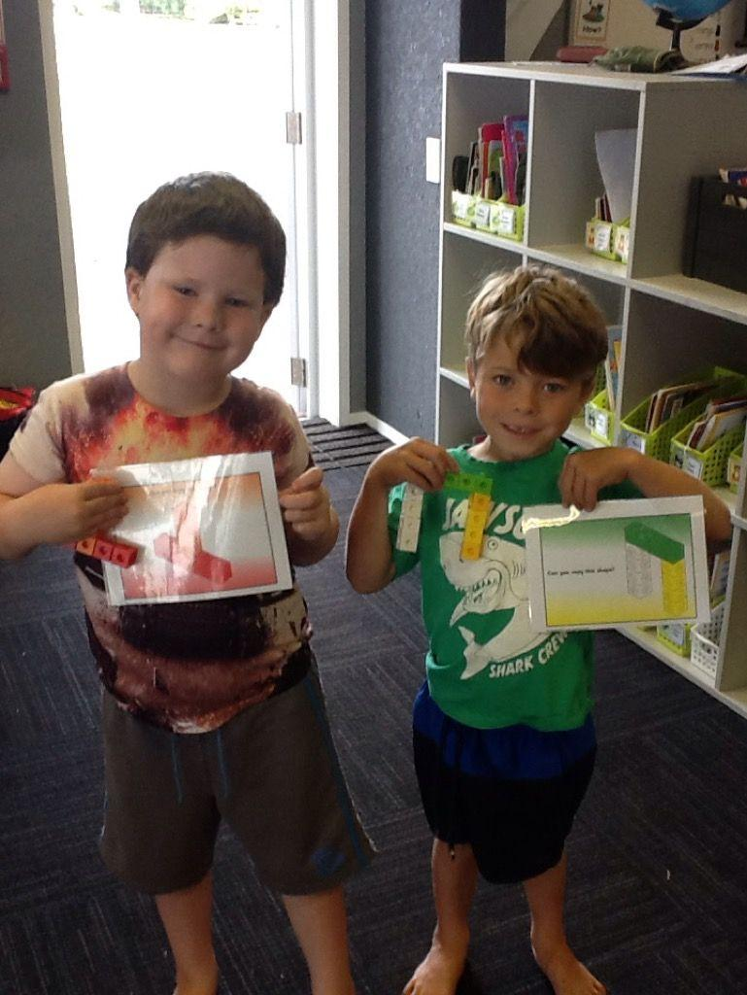
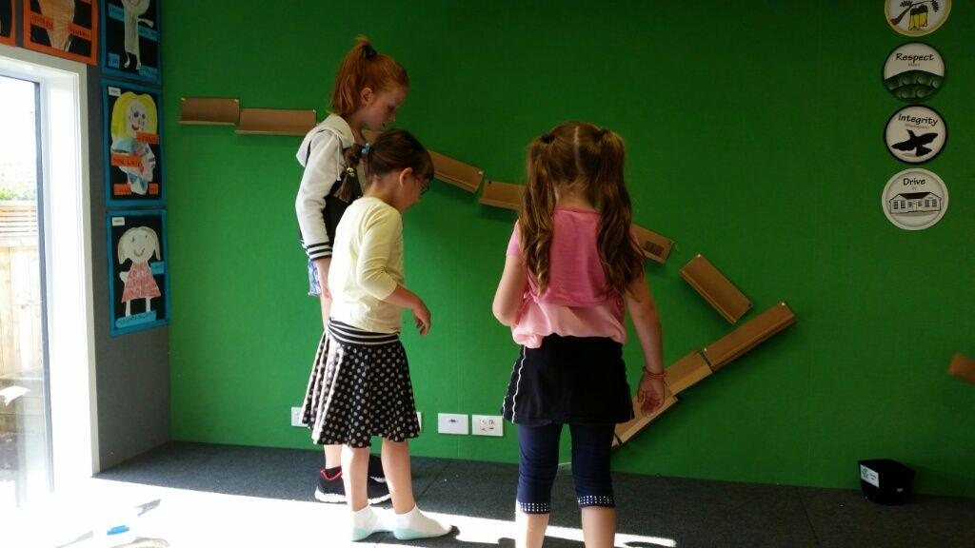
Notes:
Hands on problem solving every friday for 1 block.

Slide 34
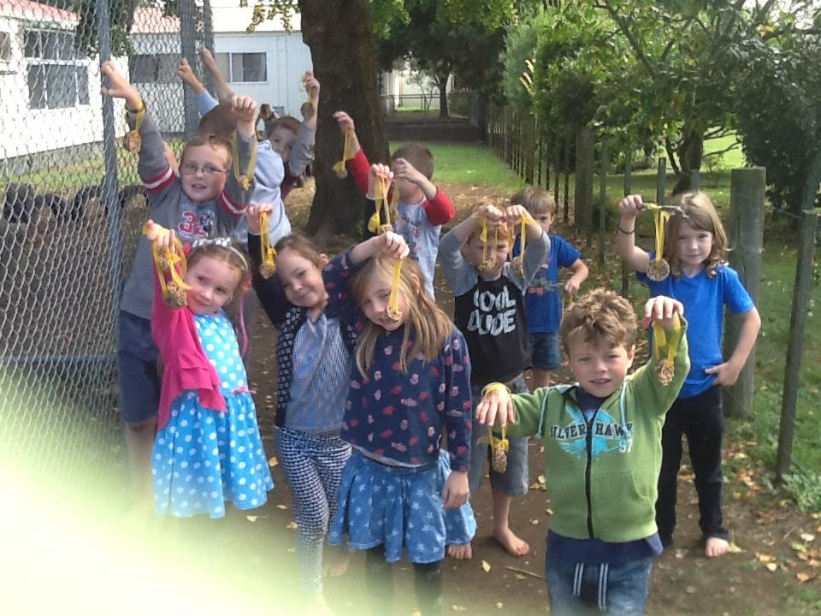
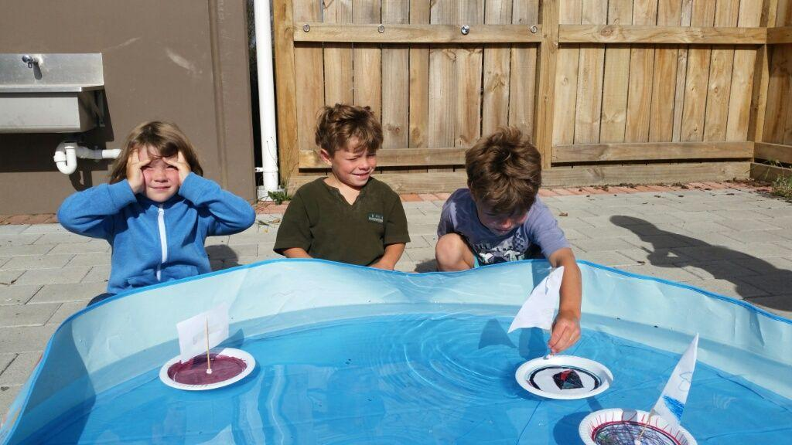
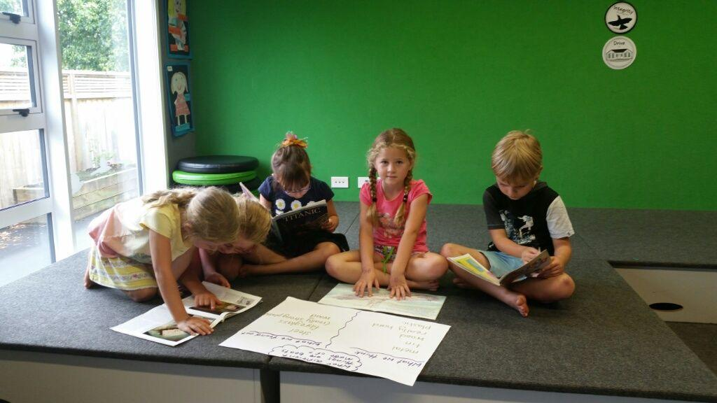
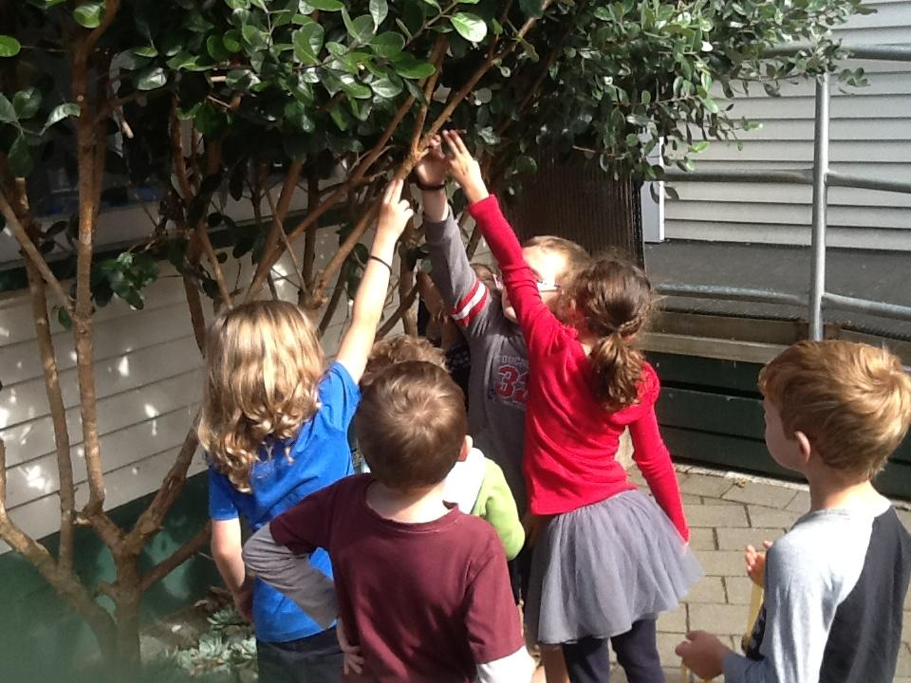
Notes:
Friday Inquiry groups
Trialled individual inquiries in 2015 - working with seniors - self confessed disaster
Teacher facilitated - but driven by student voice/ideas - share re outcomes of bird inquiry

Slide 35
Parent Communication Tools
Notes:
Instant messages, share individual photos with individual parents, or post class photos on class story.
Quick, simple, instant

Slide 36
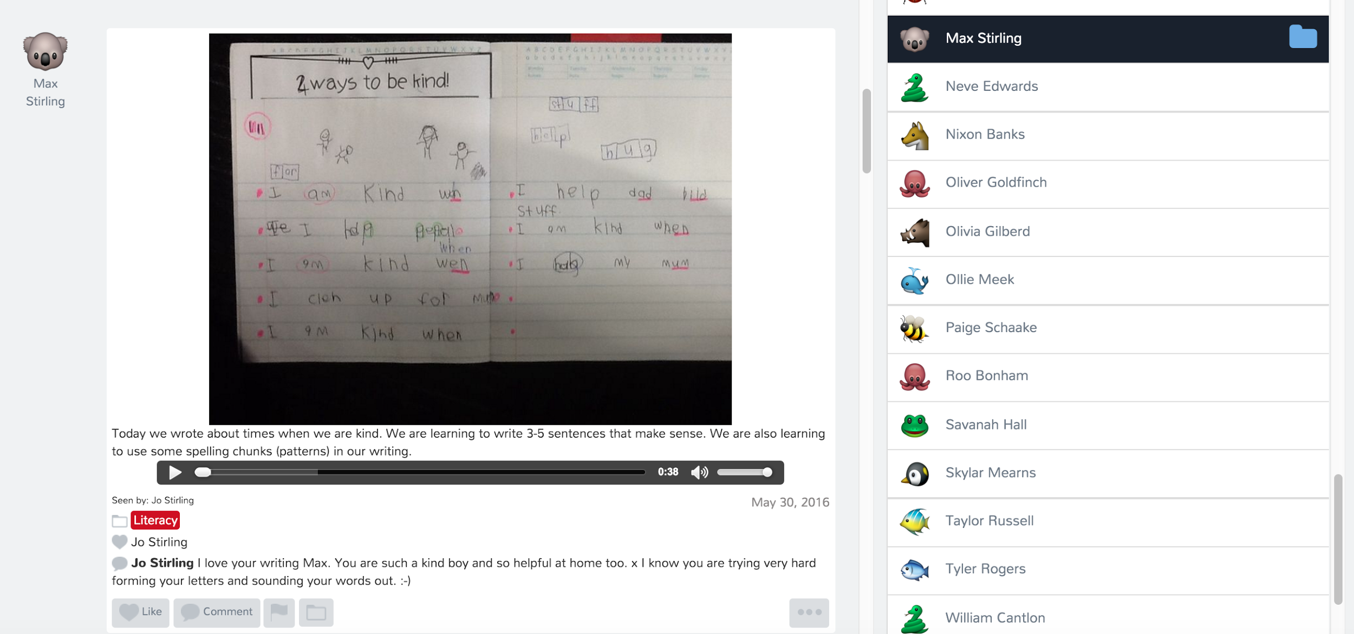
Notes:
Easy, simple, real time sharing of student learning and progress.

Slide 37
Notes:
It is fun, it is great for our professional learning, we have a coach with us all day long, we learn from each other, we question each other, but sometimes it feels like you’re on a roller coaster. We can feel oodles of emotions - in just one day!
BUT would I go back to single cell? No

