Slide 1
Silent Reading
Notes:
Give all staff a book to read. Time stamina and video behaviours.

Slide 2
The Daily 5

Slide 3
What is The Daily Five?
Notes:
Hand out sheets to all - brainstorm ideas. What do you know already? What do you think it’s about?

Slide 4
What is The Daily Five?
Framework that holds no curriculum content.
Independent literacy structure and classroom management system.
Consists of five literacy tasks that teaches students independence and provides choice.
Notes:
Hand out sheets to all - brainstorm ideas. What do you know already? What do you think it’s about?

Slide 5
What Sets Daily Five Apart?
Short whole class lessons
Target teach small groups
Conference with individuals
Assessment
Progressions
Explicitly enable students to build and maintain stamina.
Receive tailored instruction - whole class, small group, individual conferring - meeting individual needs
Reading and writing for extended periods of time
Develop independence and stamina
Provides choice (what, when, where)

Slide 6
Notes:
Since 1945, research hows that kids need to …
read to be better readers

Slide 7
Notes:
Write to be better writers!!

Slide 8
Research … ponder this
Reggie Routman and Richard Allington say that often students spend _____% of the time being instructed by teachers and _____% spent practicing
Now we know it needs to be us teaching _____% of the time and the students practicing _____% of the time.
Notes:
Cloze activity - what % do you think fills in the gaps? Guess then check.

Slide 9
Research … ponder this
Reggie Routman and Richard Allington say that often students spend 80% of the time being instructed by teachers and 20% spent practicing
Now we know it needs to be us teaching 20% of the time and the students practicing 80% of the time.
Notes:
Cloze activity - what % do you think fills in the gaps? Guess then check.

Slide 10
Notes:
It is the same as sports, you have to physically practice to get better!
Are you the 80 or the 20? I know I’m not at 20 yet!!!

Slide 11
The Daily Five does NOT hold content, it is a structure.
Content comes from your curriculum

Slide 12
What does it look like?
Short periods of whole class instruction alternated with rounds of Daily 5

Slide 13
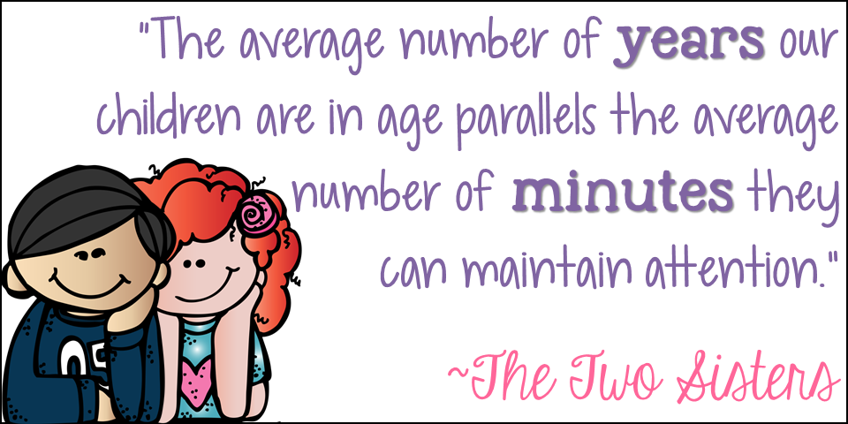
Notes:
Michael Grinder’s research shows that a child’s age is equal to how many minutes of direct instruction they can stick within the upper cortex of their brain. After that time, thinking shifts to the lower cortex (which controls eating, sleeping, breathing). THAT’S WHY DIRECT INSTRUCTION LESSONS NEED TO BE BRIEF!!!

Slide 14
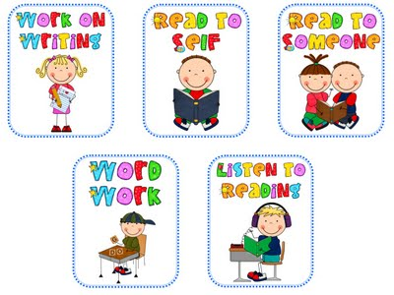
But there isn’t time for 5 rounds!
Daily 5 because there are five literacy components.
It is NOT called The Daily Five because they have to do all 5 each day.
Notes:
Why is it called The Daily Five? There isn’t time for 5 rounds! It is called the Daily Five because there are five literacy components for children to chose from. These components are … It is NOT called The Daily Five because they have to do all 5 each day.

Slide 15
Notes:
Trusting children is the underpinning of what makes the D5 work. When trust is combined with explicit instruction, our students acquire the skills necessary to become independent learners. The D5 works because we gradually build behaviours that can be sustained over time so children can easily be trusted to manage on their own.
Although giving children the power to choose makes us a little nervous, it puts them in charge of their own learning, is self motivating and will improve their skills. Purpose + Choice = Motivation. It also fits in with new directions in education (personalised learning, progressions etc.)
A sense of community provides members with ownership to hold other accountable for behaviours of effort, learning, order and kindness. During D5 the class becomes a community that works together to encourage and support each other.
Setting up D5 helps students understand the urgency of why they need to read and write. How do I become better - I read… I write.

Slide 16
Trusting Students
Trusting children is the underpinning of what makes the Daily Five work.
When trust is combined with explicit instruction, our students acquire the skills necessary to become independent learners.
The Daily Five works because we gradually build behaviours that can be sustained over time so children can easily be trusted to manage on their own.

Slide 17
Providing Choice
Although giving children the power to choose makes us a little nervous, it puts them in charge of their own learning, is self-motivating, and will improve their skills.
Purpose + Choice = Motivation

Slide 18
Nurturing Community
A sense of community provides members with ownership to hold others accountable for behaviors of effort, learning, order, and kindness.
During Daily Five the class becomes a community that works together to encourage and support each other.

Slide 19
Create a Sense of Urgency
Answers the questions “Why do we have to do it?” & “What’s in it for me?”
When people understand the reason for a task, it establishes motivation and becomes a force that keeps them persevering.
Sense of urgency comes from understanding the why.

Slide 20
Building Stamina
Lays the foundation for success as it gives children the support they need.
Teaching children how to read on their own for extended periods of time each day creates the self-winding learner that is actively engaged in the reading process because they have the stamina to be independent.

Slide 21
Stay out of the Way
How can students make decisions on their own and monitor themselves regarding their progress if they are never given the chance to try it on their own?
After training, children understand what is expected of them, have practiced the strategies, and have built their stamina… now we need to stand back and let them be independent.

Slide 22
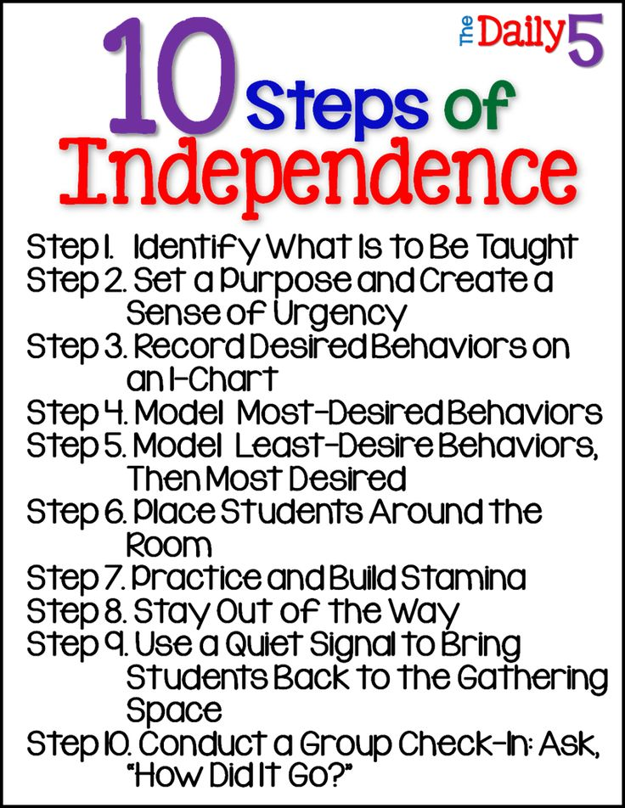
Notes:
Review video from silent reading - choose the barometer child (maybe Juliet)
Model 10 steps of independence with Becky/Juliet Use an IChart

Slide 23
What do you need to begin Daily 5?
Gathering place
Develop concept of ‘Good Fit’ Books and IPICK
Individual Book Boxes
Create Anchor Charts (I-Charts)
Practice, Practice, Practice
Check-in signals and procedures
Student Reflection
Modelling correct and incorrect behaviours

Slide 24
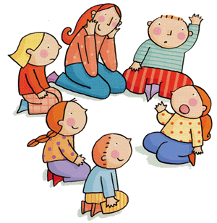
Establish a Gathering Place
Notes:
Large enough for whole class
Limited distractions on the floor, monitor behaviour during whole class sessions, close proximity for peer talking/thinking
Gathering on floor signals a shift in activity and thinking - brain break, movement of bodies

Slide 25
Three Ways to Read a Book
Can you think of 3 different ways to ‘read’ a book?

Slide 26
Good Fit Books
Independent reading or ‘good fit’ books is one students can read with 99% accuracy (Richard Allington, March 2009)
If it’s too hard = increased off task behaviour (Gambrell, Wilson & Grant, 1981)
Spend time teaching how to choose a ‘good fit’ book.
There is more to choosing a ‘Good Fit’ book than just reading the words - interest in a topic and the ability to comprehend are important too.

Slide 27
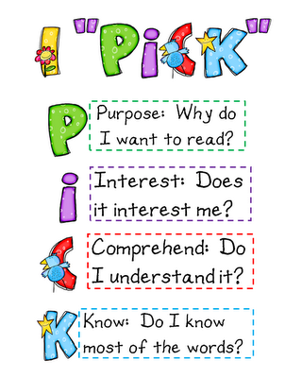
Notes:
Shoe Story/analogy - (bring in shoes to model)
Variety of books … magazines, etc.

Slide 28
Book Boxes for All
Notes:
Separate boxes for each student
5-10 books in a box - self selection (depending on age)
Literacy books - independent writing journal, reading activity/word work etc.
Assigned spot in class

Slide 29
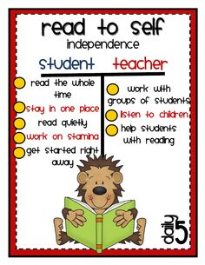
Anchor Charts (I-Charts)
Notes:
Large charts created by teacher in front of class
Makes thinking permanent and visible in the classroom
Read to Self, Work on Writing, Word Work, Listen to reading, Read to Someone

Slide 30
Short Intervals of Repeated Practice
Notes:
Brain receives input through 3 different external memory systems; visual, auditory, and kinesthetic
Memory stored in kinesthetic system evokes the longest memory.
Kinesthetic learning experiences are provided and then labeled so children hear and feel what theya re doing. This movement is stored in muscle memory and becomes part of their behaviours
Daily practice and constant review of I Charts - increase stamina each day

Slide 31
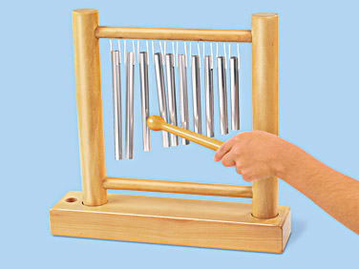
Signals and Check-In
Notes:
Teach children to respond to a signal so they know it is time to gather and check back in.
You want something that will grab attentions but not break the tone of a classroom.
Explain the signal and its purpose on the first day of the year.
Then, practice, practice, practice.

Slide 32
Student Self Reflection - Check In
Below Standard
At Standard
Above Standard

Slide 33
Correct Model/Incorrect Model
https://www.thedailycafe.com/articles/desirable-behaviors-and-least-desirable-behaviors-modeled

Slide 34
Notes:
use the 10 steps of Independence when introducing each component of D5

Slide 35
Notes:
D5 is made up of 5 components ...

Slide 36
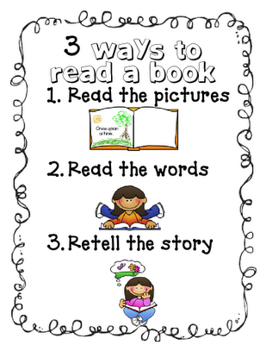
Read to Self
Teach 3 ways to read a book.
Teach how to choose ‘Good Fit Books’.
Teach IPICK strategy.

Slide 38
Work on Writing
Model what to do when writing words you can’t spell.
Set up a Writing Notebook.
What to write about …
Make a list of ‘topics’ (dog, holiday, family)
Make a list of possible text types (letters, lists, narratives)
Display lists for students reference

Slide 39
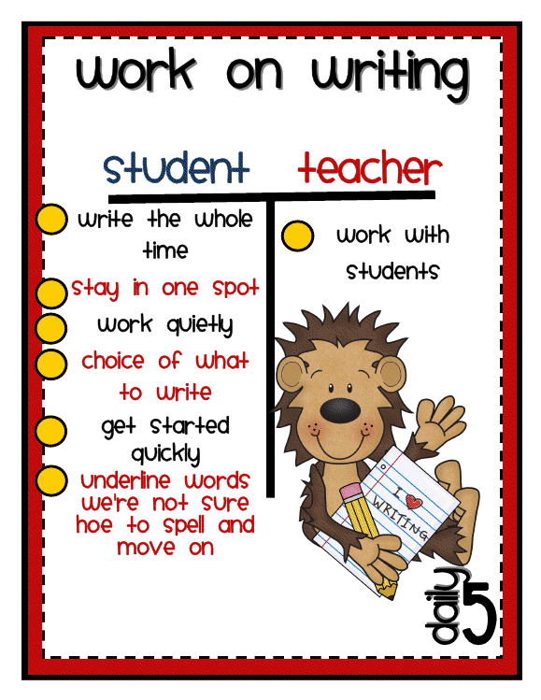

Slide 40
Choice
Allow students choice after introducing Read to Self and Work on Writing.
Students are motivated, engaged and productive when in control of their schedules.
Introduce choice as the most exciting thing ever!
Let students know you trust them to be independent.

Slide 41
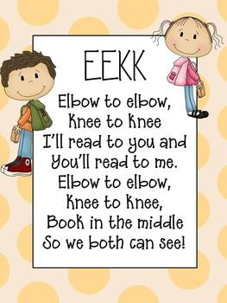
Read to Someone
Model and Practice …
EEKK
Check for understanding
I Read, You Read
How to Choose Books
How to Choose a Partner
Coaching or Time

Slide 42
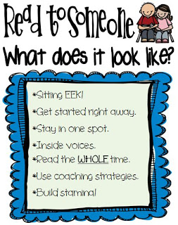

Slide 43
Listen to Reading
Model and practice material set up and pack-up of technology.
Model and practice listening and following along with words and/or pictures.
Model and practice listening to a short story, finishing it, and starting a new story.

Slide 44
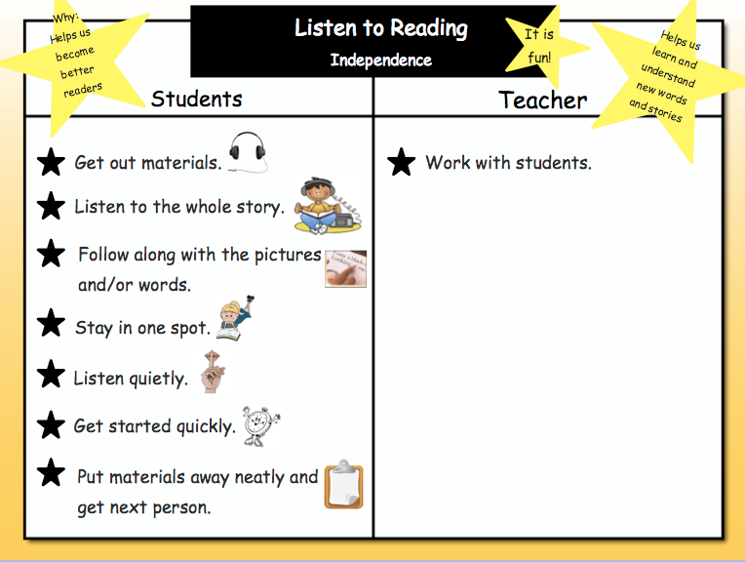

Slide 45
Word Work
Introduce materials and their location
Model set up and pack up and how to use them independently.
High Frequency Words.
Spelling patterns and rules.

Slide 46
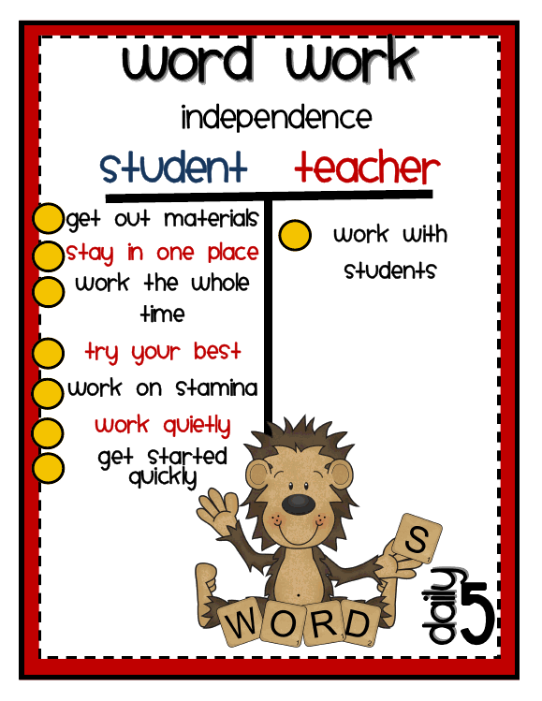

Slide 47
Reliever
The children are so well trained in Daily 5 routines they actually teach the reliever!

Slide 48
If you encounter problems … ask yourself these questions:
Did I allow enough time for training muscle memory?
Have I reviewed the I-Charts?
Am I staying out of the way and allowing the children to work independently?
Am I allowing choice?
Are some children allowed to share each day?
Have I had behaviours modelled correctly and incorrectly?
Who can I collaborate with for support?

